Slide 1



Home
Techmovr Design
Doula For Dad
Ideation
Leveraging technology to push culture forward

Slide 2


Slide 3


Slide 4

Ideation
Learning Experience

Slide 5
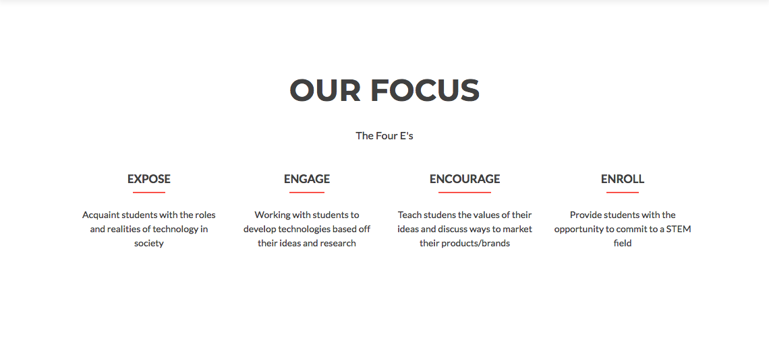
Ideation
Learning Experience
For discussion around work for fatherhood. Continued discussion and development etc etc. Next steps
For discussion around work for fatherhood. Continued discussion and development etc etc. Next steps
For discussion around work for fatherhood. Continued discussion and development etc etc. Next steps

Slide 6
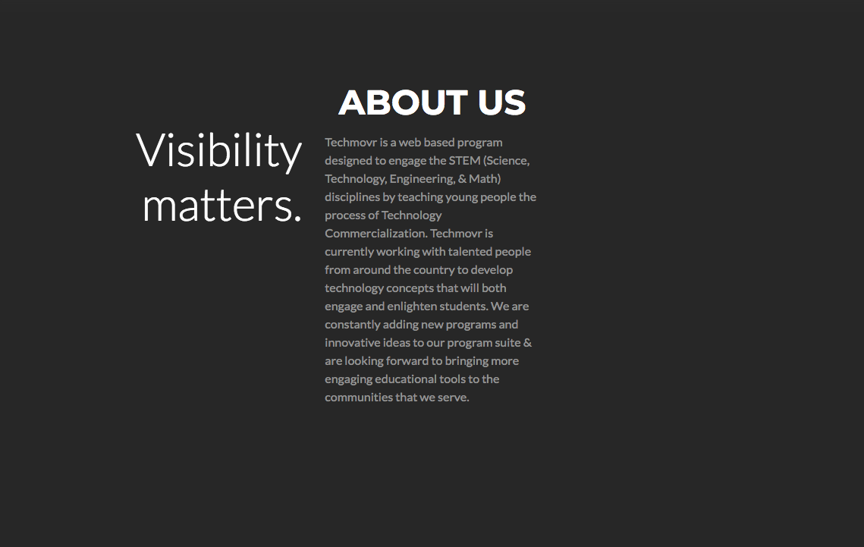

Visibility Matters For discussion around work for fatherhood. Continued discussion and development etc etc. Next steps. Continued discussion and development etc etc. Next steps Continued discussion and development etc etc. Next steps. Continued discussion and development etc etc. Next steps. Continued discussion and development etc etc. Next steps. Continued discussion and development etc etc. Next steps. Continued discussion and development etc etc. Next steps Continued discussion and development etc etc. Next steps. Continued discussion and development etc etc. Next steps. Continued discussion.
Visibility Matters

Slide 7
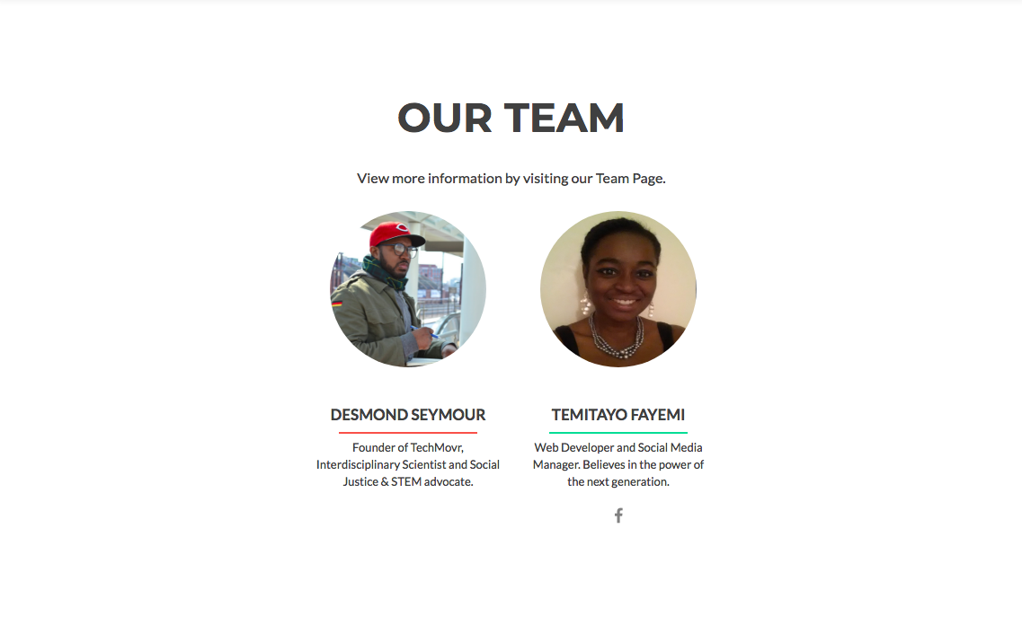

Slide 8
